Slide 1
Chapter - 7
Complex Decisions and Artificial Intelligence

Slide 2
Complex Decisions & Artificial Intelligence
Strategy
Computer analysis
of data and model.
Decision
Neural network
Tactics
Operations
Company

Slide 3





Expert System
Expert
Knowledge Base
Symbolic &
Numeric Knowledge
Expert decisions
made by
non-experts
Rules
If income > 20,000
or expenses < 3000
and good credit history
or . . .
Then 10% chance of default

Slide 4
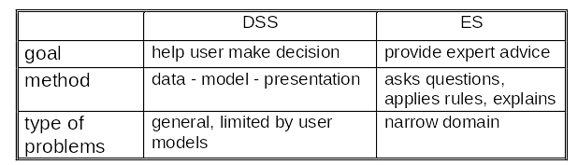
Decision Support System and Expert System

Slide 5
Expert Ssystem Example: Bank loan
the Loan Evaluation System.
What is the purpose of the loan? car
How much money will be loaned? 10,000
For how many years? 5
The current interest rate is 10%.
The payment will be $212.47 per month.
What is the annual income? 24,000
What is the total monthly payments of other loans? Why?
Because the payment is more than 10% of the monthly income.
What is the total monthly payments of other loans? 50.00
Comment from DSS
The loan should be approved, there is only a 2% chance of default.
Forward Chaining

Slide 6
Decision Tree (bank loan)
Payments
< 10%
monthly income?
No
Yes
Other loans
total < 30%
monthly income?
Yes
Credit
History
Good
Bad
No
So-so
Job
Stability
Approve
the loan
Deny
the loan
Good
Poor

Slide 7
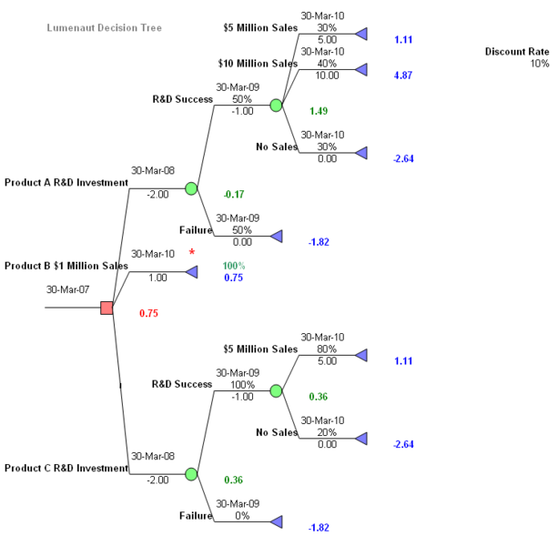

Slide 8
Frame-Based ES
Job History
Employer, Salary, Date Hired
...
...
Customer Data
Name ____
Address ____
Years at address__
Co-applicant___
Rules
Job History
Employer, Salary, Date Hired
...
...
Recommendation
Lend $$$$
at ___ interest rate
for ___ months,
with ___ initial costs.
Loan Details
Purpose Boat
Loan Amount _____
Time _____
Data for Boat Loans
Length:
Engine:
Cost New:
Cost Used:

Slide 9
ES Examples
United Airlines GADS: Gate Assignment
American Express Authorizer's Assistant
Stanford Mycin: Medicine
DEC Order Analysis + more
Oil exploration Geological survey analysis
Auto/Machine repair (GM:Charley) Diagnostic

Slide 10
ES Problem Suitability
Narrow, well-defined domain
Solutions require an expert
Complex logical processing
Handle missing, ill-structured data
Need a cooperative expert
Repeatable decision

Slide 11



ES Development
ES Shells
  Jess
  Exsys
Custom Programming
  LISP
  PROLOG
Rules
and
decision
trees
entered
by designer
Forward
and
backward
chaining
by ES shell
Maintained by expert system shell
ES screens
seen by user
Expert
Knowledge
database
(for (k 0 (+ 1 k) )
exit when ( ?> k cluster-size) do
(for (j 0 (+ 1 j ))
exit when (= j k) do
(connect unit cluster k output o -A
to unit cluster j input i - A ))
. . . )
Knowledge
engineer
Programmer
Custom program in LISP

Slide 12
Some Expert System Shells
CLIPS
  Originally developed at NASA
  Written in C
  Available free or at low cost
  http://www.ghg.net/clips/CLIPS.html
Jess
  Written in Java
  Good for Web applications
  Available free or at low cost
  http://herzberg.ca.sandia.gov/jess/
ExSys
  Commercial system with many features
  www.exsys.com

Slide 13
Limitations of ES
Fragile systems
  Small environmental changes can force revision of all of the rules.
Mistakes
  Who is responsible?
    Expert?
    Multiple experts?
    Knowledge engineer?
    Company that uses it?
Vague rules
  Rules can be hard to define.
Conflicting experts
  With multiple opinions, who is right?
  Can diverse methods be combined?
Unforeseen events
  Events outside of domain can lead to nonsense decisions.
  Human experts adapt.
  Will human beginner recognize a nonsense result?

Slide 14
Knowledge Management
A collection of a documents and data
  Created by experts
  Searchable
  With links to related topics
  Highly organized groupware
Emphasizing context
Example—business decisions
  Store problem, all notes, decision factors, comments
  Future problems, managers can search the database and find similar problems
  Better and more efficient decisions if you know the original problems, discussions, and contingency plans
Main problem—convincing everyone to enter and update the documents

Slide 15
ArtificiaI Intelligence - Research Areas
Computer Science
  Parallel Processing
  Symbolic Processing
  Neural Networks
Robotics Applications
  Visual Perception
  Tactility
  Dexterity
  Locomotion & Navigation
Natural Language
  Speech Recognition
  Language Translation
  Language Comprehension
Cognitive Science
  Expert Systems
  Learning Systems
  Knowledge-Based Systems

Slide 16
Neural Network: Pattern recognition
Output Cells
Input weights
7
3
-2
4
Hidden Layer
Some of the connections
Incomplete
pattern/missing inputs.
Sensory Input Cells

Slide 17
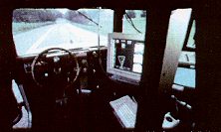
Machine Vision Example
The Department of Defense has funded Carnegie Mellon University to develop software that is used to automatically drive vehicles. One system (Ranger) is used in an army ambulance that can drive itself over rough terrain for up to 16 km. ALVINN is a separate road-following system that has driven vehicles at speeds over 110 kph for as far as 140 km.

Slide 18
Speech Recognition
Look at the user’s voice command:
Copy the red, file the blue, delete the yellow mark.
Now, change the commas slightly.
Copy the red file, the blue delete, the yellow mark.
Emergency
Vehicles
No
Parking
Any Time
I saw the Grand Canyon flying to New York.

Slide 19
Subjective (fuzzy) Definitions
Subjective Definitions
reference point
cold
hot
temperature
e.g., average
temperature
Moving farther from the reference point
increases the chance that the temperature is
considered to be different (cold or hot).

Slide 20
DSS, ES, and AI: Bank Example
Decision Support System
Expert System
Artificial Intelligence
Loan Officer
ES Rules
Determine Rules
Income
Existing loans
Credit report
What is the monthly income?
3,000
What are the total monthly payments on other loans? 450
How long have they had the current job? 5 years
. . .
Should grant the loan since there is only a 5% chance of default.
Data/Training Cases
Data
loan 1 data: paid
loan 2 data: 5 late
loan 3 data: lost
loan 4 data: 1 late
Model
Lend in all but worst cases
Monitor for late and missing payments.
Name Loan #Late Amount
Brown 25,000 5 1,250
Jones 62,000 1 135
Smith 83,000 3 2,435
...
Output
Neural Network Weights
Evaluate new data,
make recommendation.

Slide 21
DSS, ES and AI: Inventory Example
Decision Support System
Expert System
Artificial Intelligence
Data
a estimate sales
K order setup cost
h estimate holding cost
Choosing an Inventory System
Automatically Analyze
What is the cost of running out of inventory? 45,000 per day
What are daily profits? 250,000
How many suppliers are there? 8
Can more suppliers be added in an emergency? no
How close is the nearest supplier? 10 kilometres
How reliable is this supplier? very
. . .
Best choice is to use Just-In-Time inventory system. Only a 2% chance of running out of inventory for more than 2 days. . . .
Data/Training Cases
site 1 data: JIT
site 2 data: EOQ
site 3 data: JIT
site 4 data: hybrid
Model
Q* = sqrt ( 2ak / h )
Output
Inventory Levels
Neural Network Weights
Q*
time
Evaluate new data,
make recommendation.
reorder points
EOQ : Economic order quantity

Slide 22




Software Agents
Locate &
book trip.
Independent
Networks/Communication
Uses
  Search
  Negotiate
  Monitor
Software agent
Vacation
Resorts
Resort
Databases

Slide 23
AI Questions
What is intelligence?
  Creativity?
  Learning?
  Memory?
  Ability to handle unexpected events?
  More?
Can machines ever think like humans?
How do humans think?
Do we really want them to think like us?

Slide 24
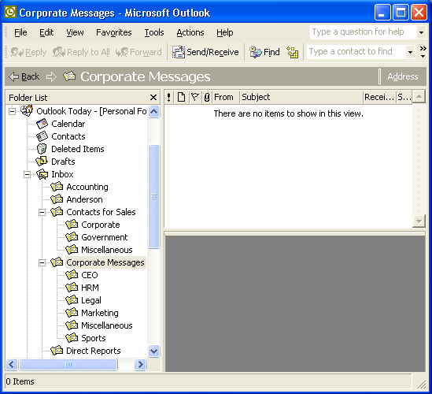
Appendix: E-Mail Rules - Folders
Folders make it easy to organize and handle your mail.
Simple rules from the Tools + Organize button move messages directly to the specified folder.

Slide 25
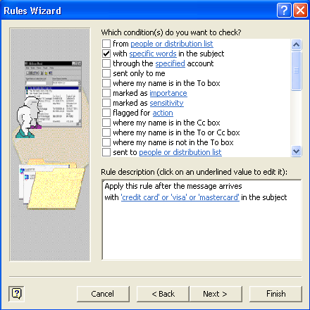
Rules: Conditions
The Tools + Rules Wizard makes it easy to create rules. Begin with a blank rule.
Set the Conditions
Set the Actions
Define Exceptions
A sample rule to handle unsolicited credit card applications.

Slide 26
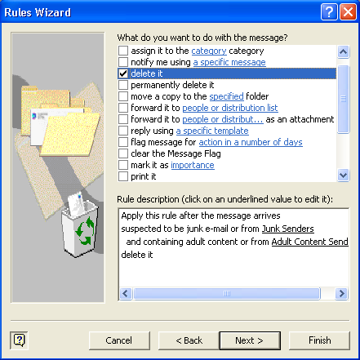
Rules: Actions
Choose an action.
You can choose multiple actions, but be careful. The marking options are often combined.

Slide 27
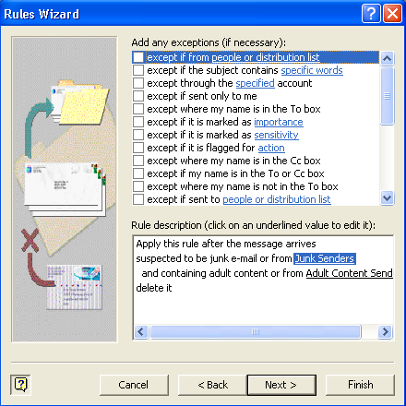
Rules: Exceptions
Rules can have exceptions. For example, you might want to delete company newsletters—unless one has your name in it.

Slide 28
Rule Sequences: Decision Tree
Message from
Expense
Accounting
Expenses Folder
Rule 1
Set expenses category
Move it
Expenses category
Subject: Payment
From boss,
Subject: Expenses
Rule 3
Rule 2
Action: Mark important and notify.

Slide 29




Strategic Analysis
Connections to suppliers and customers.
Competition
Become the best firm in the industry. Block the competitors by keeping your customers happy.

Slide 30
Strategy Formulation
Do a situation analysis, self-evaluation and competitor analysis: both internal and external; both micro and macro.
Concurrent with this assessment, objectives are set.
  vision statements (long term view of a possible future),
  mission statements (the role that the organization gives itself in society),
  overall corporate objectives (both financial and strategic),
  strategic business unit objectives (both financial and strategic), and tactical objectives.
These objectives should, in the light of the situation analysis, suggest a strategic plan. The plan provides the details of how to achieve these objectives.

Slide 31
Strategy Implementation
Allocation of resources (financial, personnel, time, technology support)
Establishing a chain of command or some alternative structure
Assigning responsibility of specific tasks/processes to individuals or groups
Management of the process. Monitoring results, comparing to benchmarks, evaluating the efficiency.
Acquiring the necessary resources, developing the process, training, process testing, documentation, and integration with inheritance processes.

Slide 32
Michael Porter’s Five Forces Model
Threat of
New Entrants
Bargaining Power
of Suppliers
Rivalry Among
Existing Competitors
Bargaining Power
of Buyers
Threat of Substitute
Products or Services
The Porter 5 forces analysis is a framework for industry analysis and business strategy development developed by Michael Porter in 1979. It uses concepts developed in Industrial Organization (IO) economics to derive 5 forces that determine the competitive intensity and therefore attractiveness of a market.

Slide 33
Driving Force : Competition
Competition is increasing in many industries.
Competition encourages firms to hold down costs, provide more variety, and provide new and better service to customers.
According to microeconomic theory, no system of resource allocation is more efficient than pure competition.
The greater selection typically causes lower prices for the products compared to what the price would be if there was no competition (monopoly) or little competition (oligopoly).

Slide 34
Harvard Business Strategy
Formulation
(Deciding what to do.)
Implementation
(Achieving results.)
1. Identification of opportunity and risk.
2. Material, technical, financial, & human resources.
3. Personal values and objectives.
4. Noneconomic responsibility to society.
Corporate Strategy
Pattern of
purposes and
policies
defining the
company and
its business
1. Org. structure & relation.
Division of work.
Coord. divided responsib.
Information systems.
2. Org. processes & behavior.
Standards and measurement.
Motivation & encouragement systems.
Control systems.
Recruit & develop managers.
3. Top leadership.
Strategic
Organizational
Personal

Slide 35
Production
Chain
parts
supplier
parts
supplier
parts
supplier
warehouse
warehouse
supplier
supplier
supplier
tool
manufacturer
workers
Manufacturer
wholesaler
wholesaler
distributor
distributor
distributor
retail store
retail store
retail store
retail store
Consumers

Slide 36
Methods to Gain
Competitive
Advantage
Barrier
To Entry
Supplier
Supplier
Supplier
Ties To
Suppliers
Decreased
Costs
Firm
Rival
Improved
Quality
Control Of
Distribution
Wholesale
Ties To
Customers
Innovation and
Differentiation
Consumer
Consumer
Consumer
Increased
Switching Costs
Consumer
Consumer
Consumer
Consumer

Slide 37
Barriers to Entry
Economies of Scale (size)
Economies of Scope (breadth)
Product Differentiation
Capital requirements
Cost Disadvantages (independent of size)
Distribution Channel Access
Government Policy

Slide 38
Competitive Advantage with IS
Barriers to Entry
  Additional costs of creating an information system.
Distribution Channels
  Prevent others from entering the industry.
Switching Costs
  Consumers invite learning and data transfer costs.
Lower Production Costs
  IS to cut costs.
Product Differentiation
  Add new features or create new products with IT.
Quality Management
  Monitoring production lines and analyzing data.
Value Chain
  Expanding forward or back the value chain to find greater profits.

Slide 39
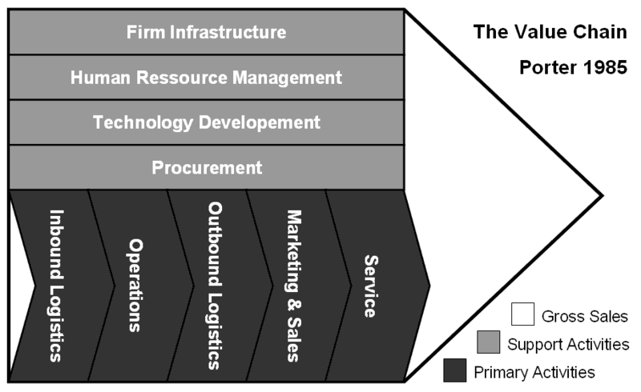
Value Chain
Value-adding activities of an organization.
The "primary activities" include: inbound logistics, operations (production), outbound logistics, marketing and sales, and services (maintenance).
The "support activities" include: administrative infrastructure management, human resource management, R&D, and procurement.
The costs and value drivers are identified for each value activity. Its ultimate goal is to maximize value creation while minimizing costs.

Slide 40
Process Innovation
Suppliers
Production
Research
Logistics/
Supply
Engineering
and Design
Management
Manufacturing
Marketing
Customer
Service
Sales and
Order
Management
Customers

Slide 41
Developing Strategies
Business Strategies
and Priorities
- Cost leadership
- Differentiation
- Innovation
- Linkages
Corporate Strategy Development
monitor
rivals
expectations
goals
rivalry
strengths
weaknesses
opportunities
critical success factors
Process Changes
Data Needs
IS Changes
- Re-engineering
- Organization
- Decentralization
Performance Measures
- ROA - ROI
- EPS - Growth
- Subjective
Market Measures
- Market share
- Concentration
- Growth
- Profitability
System
Development
& Implementation
Business Operations & Rules
Existing Data and IS

Slide 42
Search for Innovation with IS
Research
  Analysis & modeling, project management, work group support, databases, decision support.
Engineering & Design
  CAD/CAM, testing, networks, work group support.
Manufacturing
  Mass customization, links to customers & suppliers, quality monitoring, expert systems for maintenance, production databases, business integration.
Logistics & Supply
  Just-in-time linkages, forecasts, models, links for design, transaction processing.

Slide 43
Search for Innovation with IS
Marketing
  Frequent buyer database, target market & media analysis, survey design and analysis, multimedia promotion design, links to customers and designers.
Sales & Orders
  Portable computers for sales, ES for order customization, work group tools for customer support.
Service
  Phone support, GIS locators, scheduling, ES diagnostics, databases.
Management
  EIS, e-mail, bulletin boards, decision support systems, personal productivity tools, work group support
  Links to service providers
    Accountants
    Consultants
    Lawyers, . . .

Slide 44
Research with IS
Analysis and models
Statistical analysis of data
Project management and budgeting
Work-group collaboration and communication

Slide 45
Engineering and Design with IS
CAD/CAM
Integrated design database
Production databases and model testing
Expert Systems for manufacturability
Work group communication

Slide 46
Manufacturing with IS
Links to customers
Links to suppliers
Mass customization
Robotics/CNC
Diagnostic Expert Systems
Quality monitoring and control

Slide 47
Logistics and Supply with IS
Just-In-Time Inventory and EDI
Configuration and design
Searching for availability, pricing, . . . networks

Slide 48
Marketing with IS
Frequent buyer databases
Point-of-Sale and trends
Statistical analysis of data
Geographic Information Systems
Links to external marketing agencies
Multimedia development of promotions
Internet

Slide 49
Sales and Orders with IS
Sales force automation, hand-held computers
Customer Internet access
Expert Systems for product and option selection
Expert Systems for configuration and shipping
Front-line support: ES, e-mail, work groups

Slide 50
Service with IS
Portable computers for service anywhere
Databases (e.g., customer service)
Location monitoring of service personnel
Product internal, automatic diagnostics
Expert System diagnostic tools

Slide 51
Management with IS
Executive Information Systems
Simulation (and rivalry games)
Links to external partners (accounting, law, . . .)
Electronic conferencing
Work group communication, e-mail
Standardization, Modularization, Franchises
Knowledge Workers
Client-server instead of hierarchical computing

Slide 52
Strategy Analysis
Product Differentiation
  Skills & Resources
    Strong marketing.
    Product engineering.
    Basic research.
    Distribution channel cooperation.
  Organization Requirements
    Internal coordination.
    Incentives for innovation.
    Resources to attract skills.
  Risks
    Competitors imitate.
    Customers do not accept.
    Cost is too high.
Cost Leadership
  Skills & Resources
    Continued capital investment.
    Process engineering.
    Continuous quality improvement.
    Tight supervision of costs.
    Products designed for low cost.
    Low cost distribution.
  Organization Requirements
    Tight cost controls.
    Frequent control reports.
    Highly structured org.
    Incentives based on qualitative measures.

Slide 53
Strategy Analysis
Cost Leadership
  Risks
    Competitors imitate.
    Technology changes.
    Lose production or distribution advantage.
Customer-Supplier Links
  Skills & Resources
    Influence with partners
    Communication channels
    Standards or agreements.
  Organization Requirements
    Flexibility to respond to customers.
    Service culture.
    Ability to adapt to emergencies.
  Risks
    Security threats.
    Changing standards.
    Competitors copy with more/better links.

Slide 54
Competition
Follows
IS Costs
You
Time
Transaction
Processing
Network & link
sales people
Experimental
technology
& global links
IS Costs
Rival
Time
Network & DSS
Link to suppliers
& customers

Slide 55

Changing Industry &
Government Intervention
New technology
New services
Customer
Customer
Customer
Industry 1
(expands into
industry 2)
Industry 2
(new
competitor)
Customer
Customer
Same technology
Customer
Customer
Customer

Slide 56
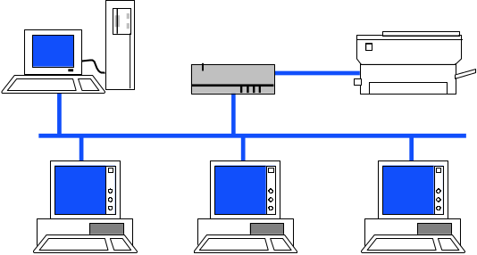
Security
Need to control access.
Need to worry about network
interceptions and hackers.
Production Firm
Hackers
or competitors
rejected
Security
firewall
Data we wish to share.
Customer
Data we want to protect.

Slide 57
E-Commerce Failures
Hundreds of dot-com firms failed in 2001 and 2002
Most relied on pure Internet revenue. Outsourcing production and shipping.
Most relied on advertising revenue—often revenue from other dot-com firms.
Many believed in the importance of being first to market and becoming the biggest, best-known firm in a niche industry.
Many believed that it was not necessary to make a profit on sales. Money from advertising and stock sales would be sufficient to keep the firm alive until the world changed.
Most were wrong.

Slide 58
Evaluating Projects
Does the project fit with business goals and management style?
Does the project improve the competitive position of the firm?
How long will any competitive advantage last?
What value or reward is created by the system?
What level of technology is needed to create the system?
  experimental
  leading edge
  established
  old-hat
What is the probability of technical success?
What is the probability of commercial success?
What are the costs involved in creating the system?
  Monetary
  Time
  Additional capital, marketing and management

Slide 59




Electronic Business
Orders, Auctions, and EDI
Small business/ supplier
Large business
Sales and CRM
The Internet
Service, orders, and information
Web hosting and Web-based services
Salesperson
Customer

Slide 60
Forms of Electronic Commerce
 | Business | Consumer
Business | B2B EDI Commodity auctions | B2C Consumer-oriented Sales Support
Consumer | C2B Minimal examples, possibly reverse auctions like PriceLine | C2C Auction sites (eBay) But many of these are dominated by small business sales.

Slide 61



Disintermediation
Production Chain
Manufacturer
E-commerce website
Retailer
Consumer

Slide 62


Distributed Services
Original
document
Company 1
The Internet
Internet Service
e.g., automated document translation
Company 2
Translated
document

Slide 63
Marketing Phases
Pre-Purchase
  Static data sites.
    Promotion.
    Product specifications.
    Pictures.
    Schematics.
    Pricing.
    FAQs.
  Interactive sites.
    Configuration.
    Compatibility.
    Complex pricing.
Purchase
  Transmission security.
  User identification.
  Product selection.
  Payment validation.
  Order confirmation.
Post-Purchase
  Service.
    Problem tracking.
    Sales leads.
  Resolve problems.
  Answer questions.
  Product evaluation.
    Modifications.
    Tracking customers.

Slide 64
Simple Static HTML Website
Main Web Page
Categories
…
Category 1
Product photo
… …
Category 2
Product photo
… …
Category 3
Product photo
… …
Product 1
Description
Price
Photo
Product 2
Description
Price
Photo
Product 3
Description
Price
Photo
Product n
Description
Price
Photo

Slide 65

Simple Website with Buy Me Button
Merchant Web site
Card Processor Site
Product
Description
Price
Buy Me
Shopping Cart
Item Price
… …
Total
Credit Card Data
Name
Address
Phone
Card Number
Check Out
Submit
Notify merchant
Customer
Notification
(Accept/Reject)

Slide 66

Credit Card Processing
Visa
MasterCard
Settlements
Validation
Online
Card
Processor
Pay registrar (Verisign) $35/year for domain name.
Pay CA (Verisign) $250/year for certificate
Pay card processor (Verisign) and Merchant bank fixed fee and value fee: 2%-5%
-$
CC
Data
+$
CC
Data
Confirm
Issuing
Bank
Merchant
Bank
Web Server
Digital
Certificate
Encrypted Card Data
CA: Verisign

Slide 67




Web Auctions
Uncertain price
Can set reserve price
Good for unique items
Efficiency depends on
  Full information
  Adequate number of participants

Slide 68


Amazon.com zShops
zShop Products
Cameras, Digital, Brand
Vendor 1
Vendor 2
Vendor 3
Vendor Transfer
Description
Price
Scanned image
Contact info
Consumer
Product search
Choose vendor
Pay for item
Transaction Processing
Amazon.com handles credit
Sends order info to merchant
Merchant ships item to consumer

Slide 69
Virtual Malls
Directory of Shops
Product category
Vendor 1
Vendor 2
Merchant Site
Products
Sales
Essentially a marketing agreement
The “mall” provides a directory to merchants
The merchant site runs on a different server

Slide 70
Web Commerce Servers
Your Web site
Products
Shopping cart
Sales
Merchants
Customers
Commerce Server Shell
Load database
Images
Descriptions
Prices
Customize site
Database
Web servers
Web/Commerce Hosting Company

Slide 71
Application Service Provider
Business Application
e.g., Accounting
Store data
Analyze data
Facilitate company
interaction
Businesses that lease the use of the application

